Slide 1
Hospital management system
Member team:yousef walid,wafaa mahamed ,ibrahim emam,hager hamdy,yassmen yasser ,manar elkholy
Supervised by dr.mona mohamed
Eng.ahmed tawfik

Slide 2
Introduction
Hospital management system is a computer system that helps manage the information related to health care and aids in the job completion of health care providers effectively. HMS came into the picture of hospital management as early as 1960 and have ever since been evolving and synchronizing with the technologies while modernizing healthcare facilities. In today’s world, the management of healthcare starts from the hands of the patients through their mobile phones and facilitates the needs of the patient.

Slide 3
Objective of project
HMS was introduced to solve the complications coming from managing all the paper works of every patient associated with the various departments of hospitalization with confidentiality. HMS provides the ability to manage all the paperwork in one place, reducing the work of staff in arranging and analyzing the paperwork of the patients. HMS does many works like:
Maintain the medical records of the patient
Maintain the contact details of the patient

Slide 4
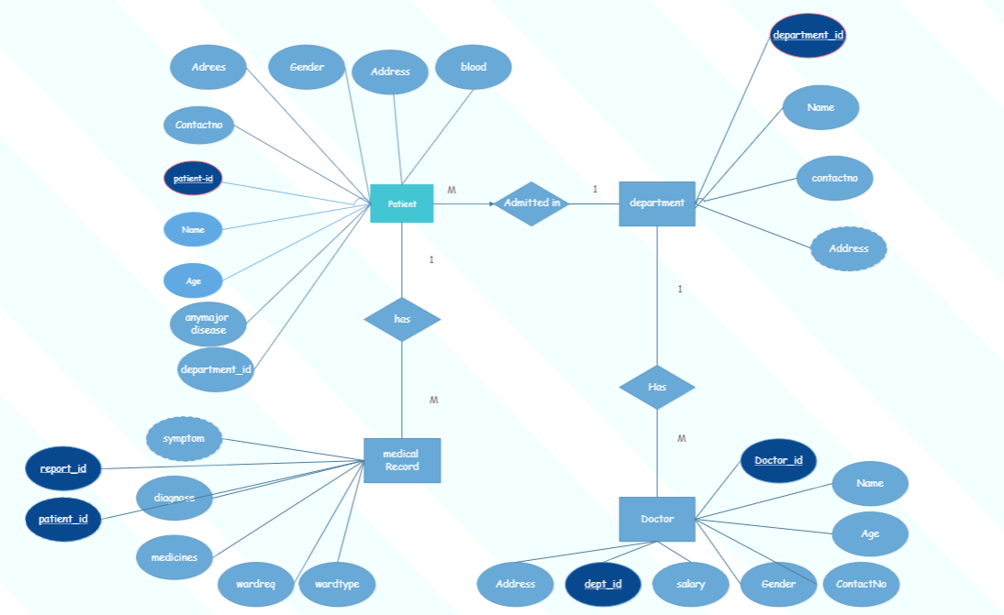
ER DIAGRAM and mapping

Slide 5
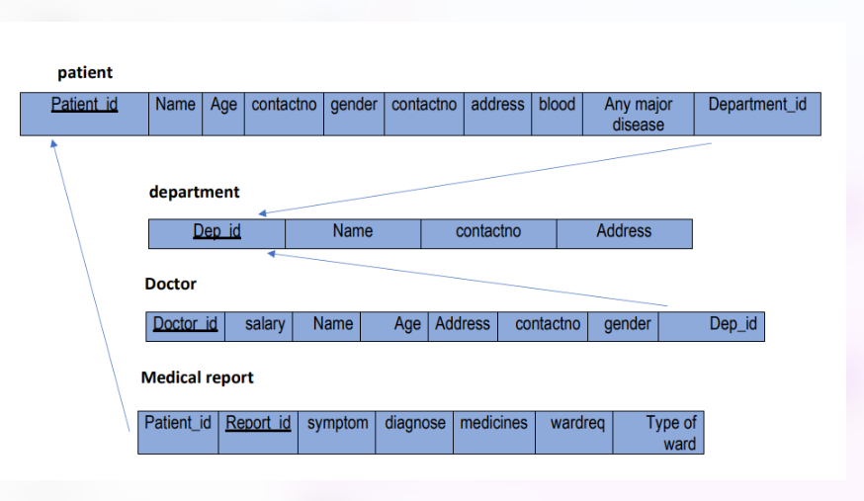

Slide 6

Login
Login Page:
In this page we have to fields username and password. When we enter incorrect username and password it will show a popup message Incorrect Username or Password. If we enter correct username or password we will move to next page. It having one more button for exit this application.

Slide 7

Home
Home Page:
After login this one is first page. In this page we have nine button and each button having different functionality .

Slide 8
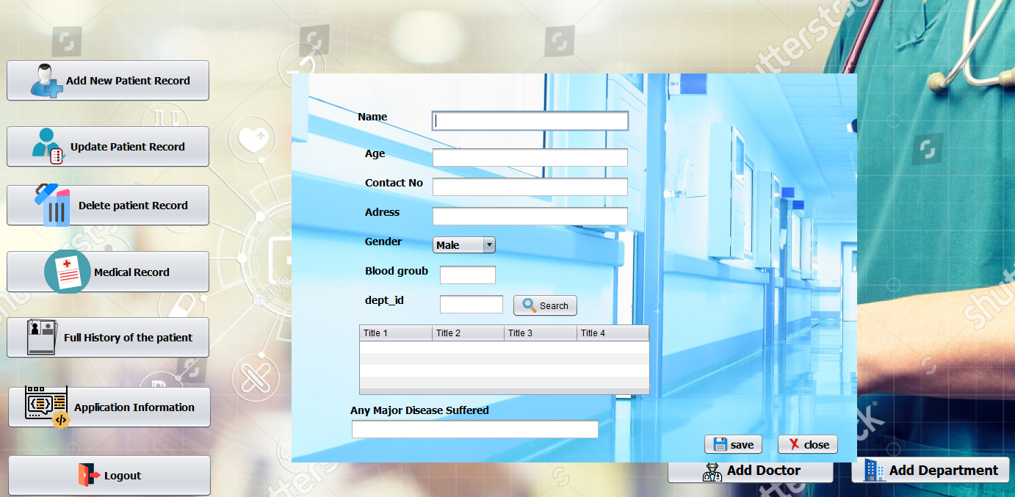
Add New Patient Page
In this page we have multiple fields to get details of patient or we can say add new patient in our database and having two buttons first one is used to save details and second one is used close this page and search to get information doctor exist in this department

Slide 9
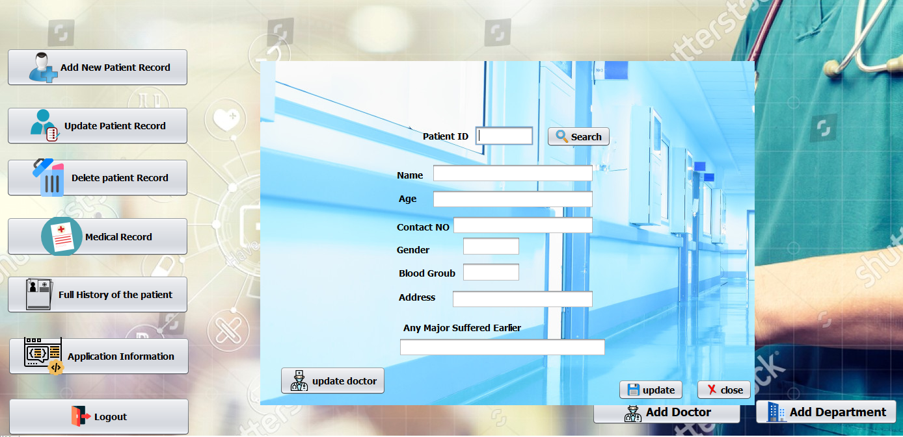
Update Patient Page
In this page first we have to enter id then we have click on search then it will show all the details of that patient. If patient does not exist then it will show error message. After that we have multiple fields to get and add diagnosis information of patient in our database and having three buttons first one is used to save details and second one is used close this page. And update doctor button to update information doctor.

Slide 10
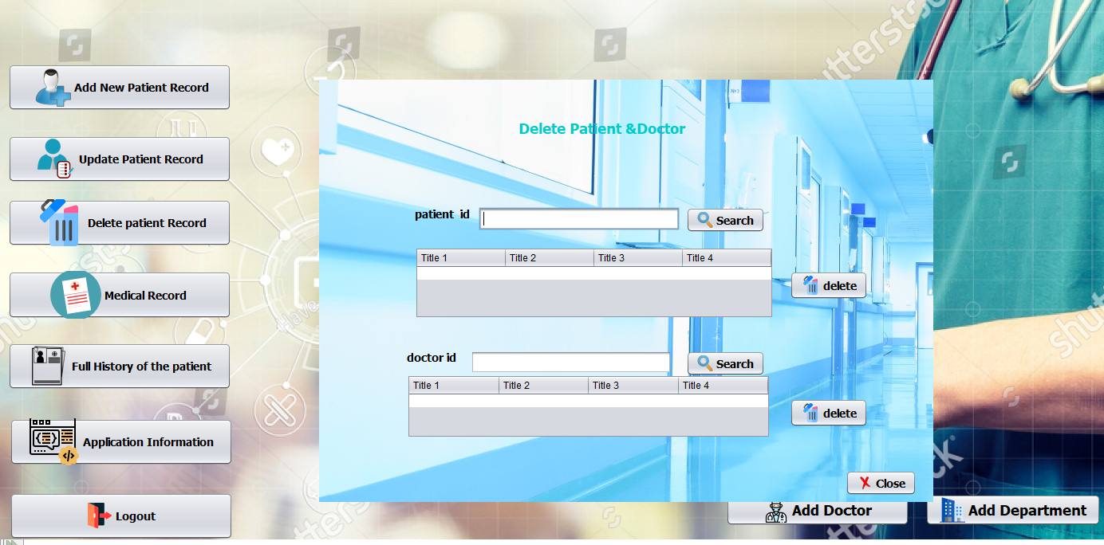
Delete Patient & doctor Page
In this page first we have to enter id then we have click on search then it will show all the details of that patient. If patient does not exist then it will show error message. having two buttons first one is used to delete details patient and second one is used close this page.

Slide 11
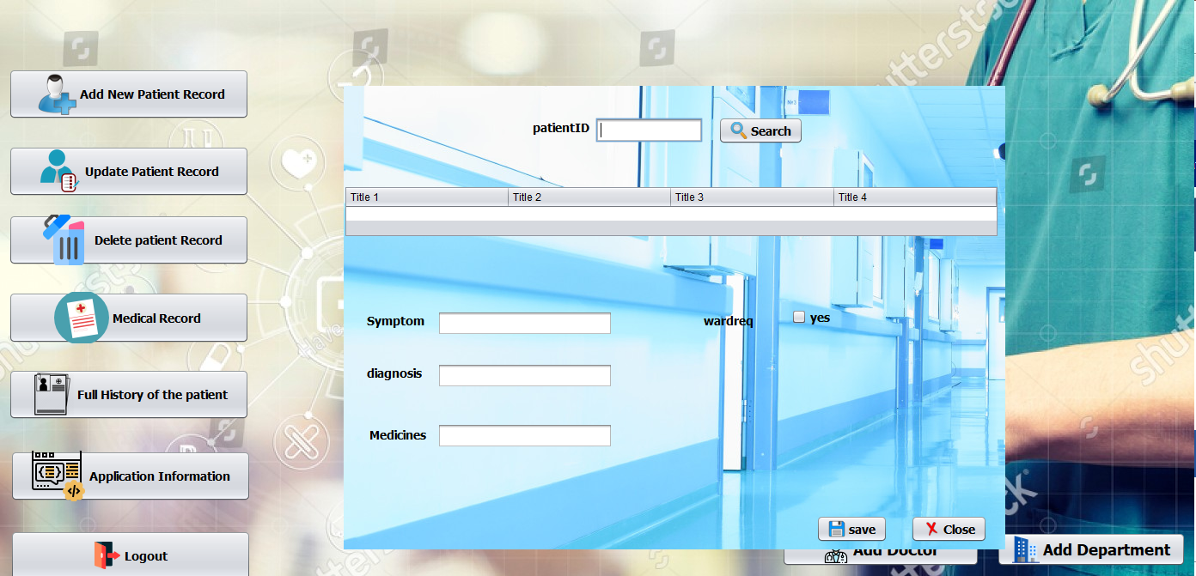
Add Diagnosis Information Page
In this page first we have to enter id then we have click on search then it will show all the details of that patient. If patient does not exist then it will show error message. After that we have multiple fields to get and add diagnosis information of patient in our database and having two buttons first one is used to save details and second one is used close this page.

Slide 12
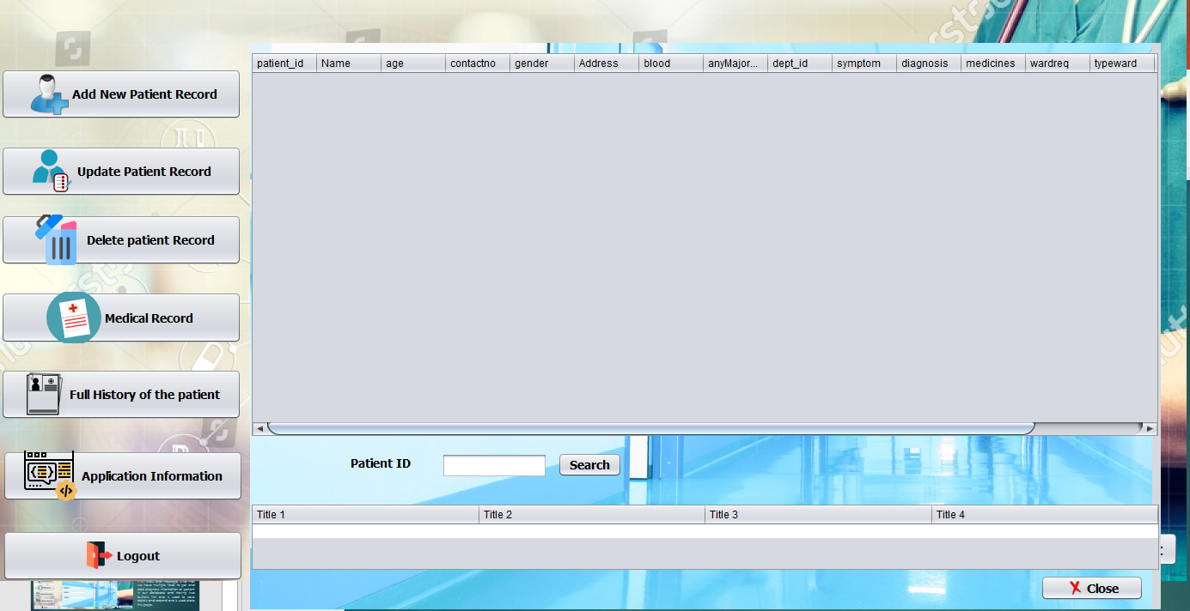
Full History Of The Patient Page
In this page we can see all the details of the patients and diagnosis information of patients. It also have a button to close this page. And search patient button using patient id.

Slide 13
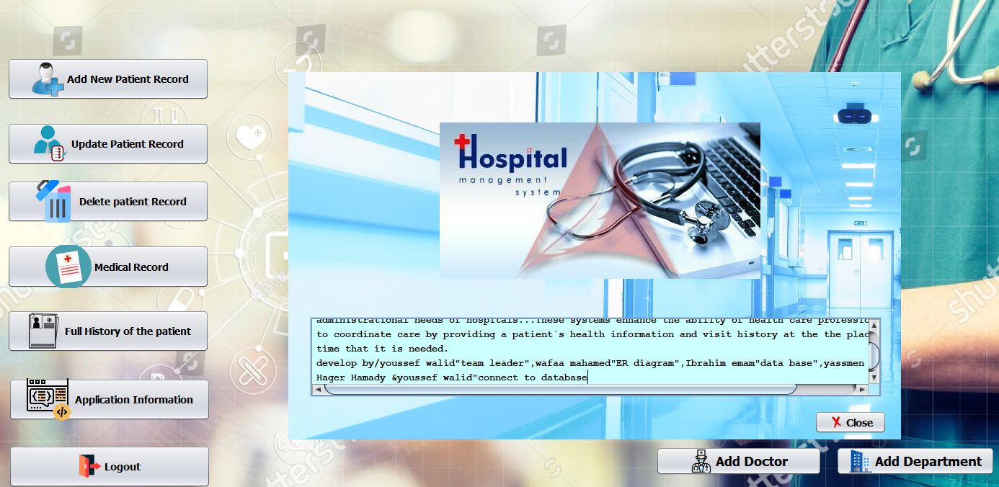
Application information
In this page we can see all the details of the patients and diagnosis information of patients. It also have a button to close this page and members of team .

Slide 14
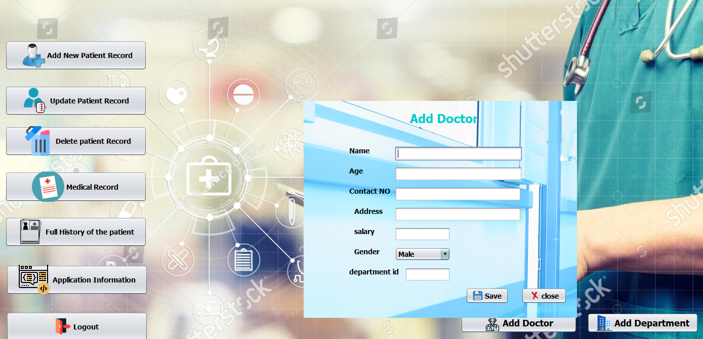
Add doctor this page
In this page we have multiple fields to get details of doctor or we can say add new doctor in our database and having two buttons first one is used to save details and second one is used close this page.

Slide 15
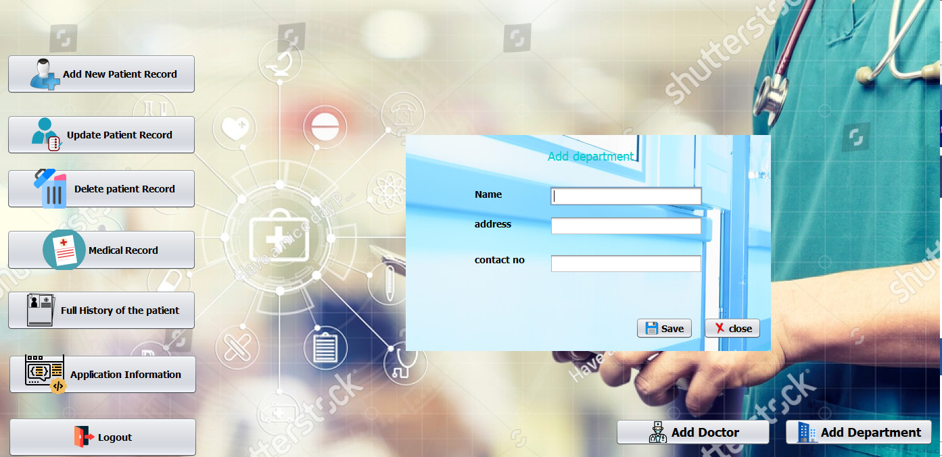
Add department
In this page we have multiple fields to get details of patient or we can say add new patient in our database and having two buttons first one is used to save details and second one is used close this page.

Slide 16
Thank you
Type with yousef walid

